Slide 1
自我介紹
nizima Live

Slide 2
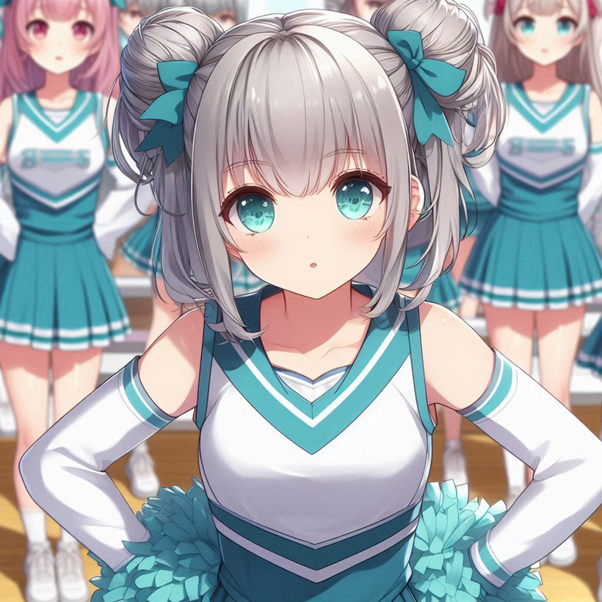
1.目標
Notes:
動漫風格的女孩子。She has silver-gray hair with a little tiffany green highlights, flat bangs, two buns, and tiffany green-pink eyes. She wore a cheerleading with her teammates.

Slide 3
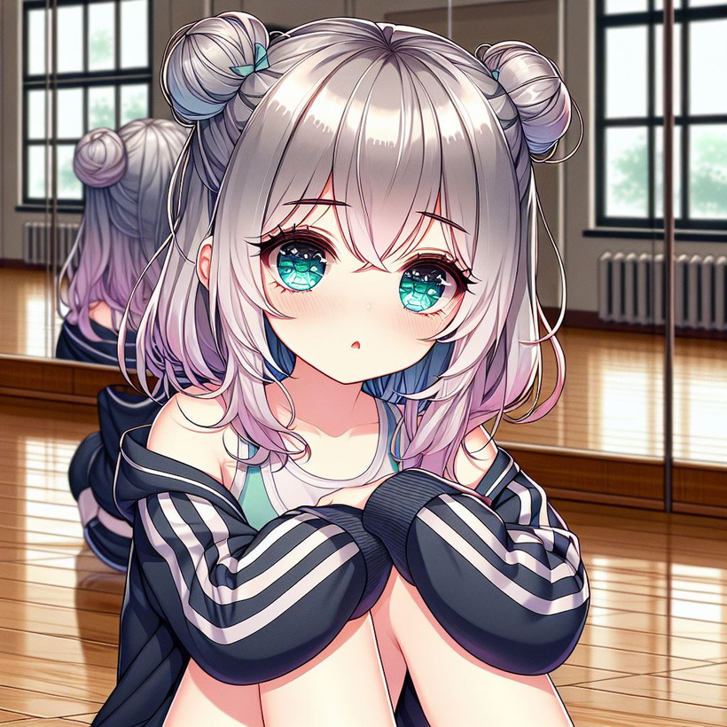
2.阻礙
Notes:
動漫風格的女孩子。She has silver-gray hair with a little tiffany green highlights, flat bangs, two buns, and tiffany green-pink eyes. She is sitting on the floor in a dance practice room, wearing sportswear and feeling very depressed.

Slide 4
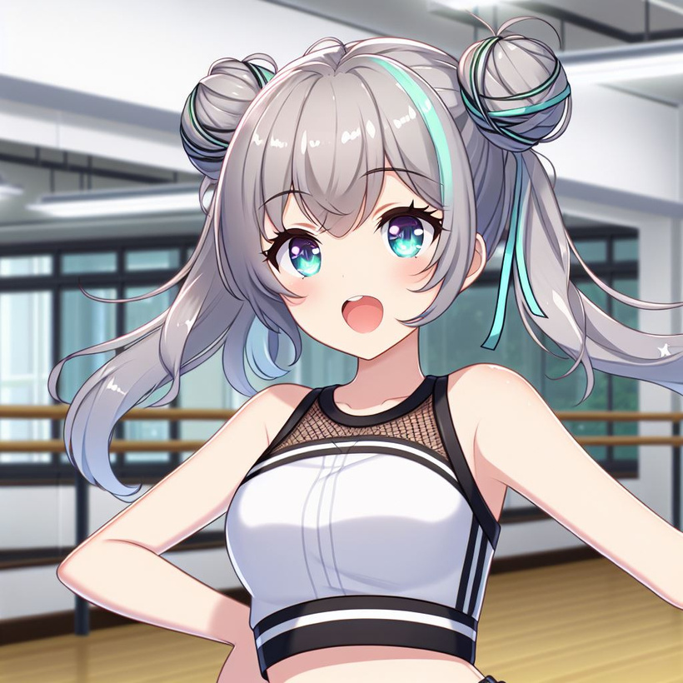
3.努力
Notes:
動漫風格的女孩子。She has silver-gray hair with a little tiffany green highlights, flat bangs, two buns, and tiffany green-pink eyes. She is dancing in a dance practice room, wearing sportswear and sweat a little.

Slide 5
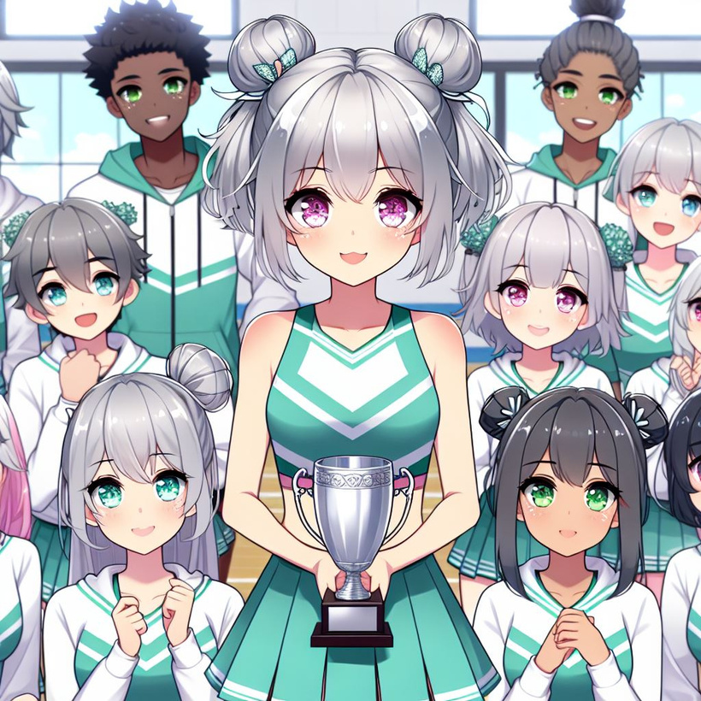
4.結果
Notes:
動漫風格的女孩子。She has silver-gray hair with a little tiffany green highlights, flat bangs, two buns, and tiffany green-pink eyes. During the cheerleading competition, she wore a cheerleading uniform and displayed the trophy with her teammates.

Slide 6
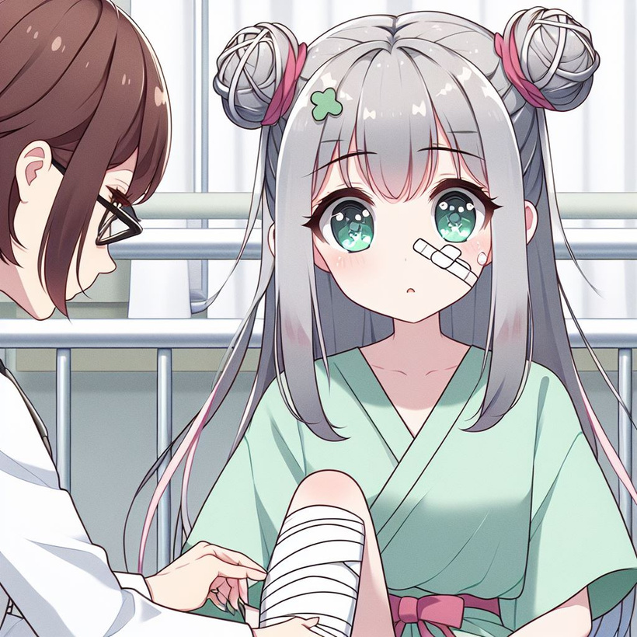
5.意外
Notes:
動漫風格的女孩子。She has silver-gray hair with a little tiffany green highlights, flat bangs, two buns, tiffany green-pink eyes, and is in the hospital, wearing a hospital gown, with an injured ankle. add some doctor by her side and need to show the injured ankle

Slide 7
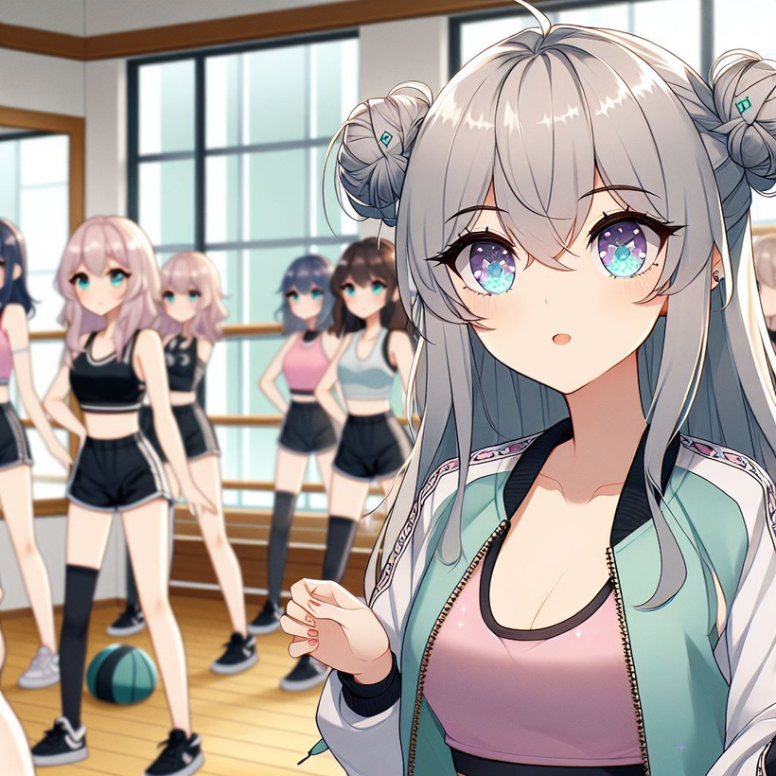
6.轉彎
Notes:
動漫風格的女孩子。She has silver-gray hair with a little tiffany green highlights, flat bangs, two buns, and tiffany green-pink eyes. She is in the dance practice room, wearing sportswear, coaching her teammates.

Slide 8
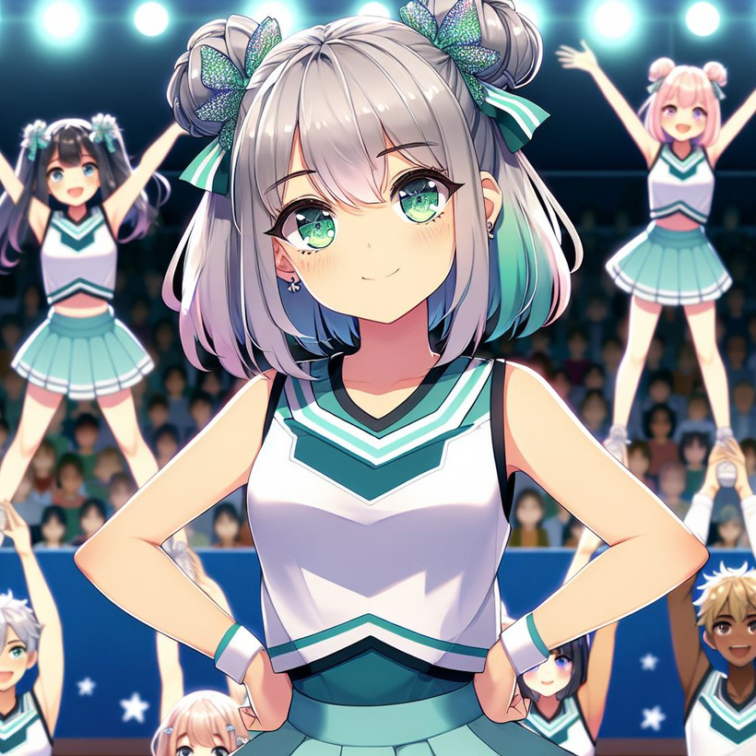
7.結局
Notes:
動漫風格的女孩子。She has silver-gray hair with a little tiffany green highlights, flat bangs, two buns, and tiffany green-pink eyes. During the cheerleading competition, she wore a cheerleading uniform and showed superb pyramid postures with her teammates.

